Slide 1


Kavin Manoharan
{BLOCKCHAIN}
TECHNOLOGY
as a solution at the right place!
www.codiscuss.in/blockchain

Slide 2
Kavin Manoharan
{...}->{...}->{...
{...}->{...}->{...
www.codiscuss.in/blockchain

Slide 3
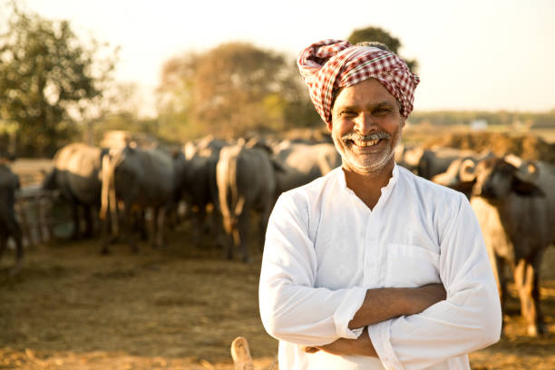
Kavin Manoharan
MILK SUPPLY CHAIN IN INDIA
In India, the milk supply chain involves multiple stakeholders like farmers, collection centers, processing units, distributors, and retailers.

Slide 4

Kavin Manoharan
CHALLENGES
Lack of transparency in milk quality and pricing
Delays in payments to farmers.
Difficulty in tracing the source of milk in case of quality issues (e.g., contamination).

Slide 5

Kavin Manoharan
OUR MISSION
A blockchain-based system is implemented to track milk from the farm to the consumer.

Slide 6
STEP 1
FARMER REGISTERS MILK DETAILS ON THE BLOCKCHAIN.
{
"ProductID": "MILK123456",
"Farmer": {
"ID": "FARM789",
"Location": "Trichy, Tamil Nadu",
"Quantity": "50 liters",
"Quality": "4.5% fat, 100% pure"
}
}
Kavin Manoharan

Slide 7
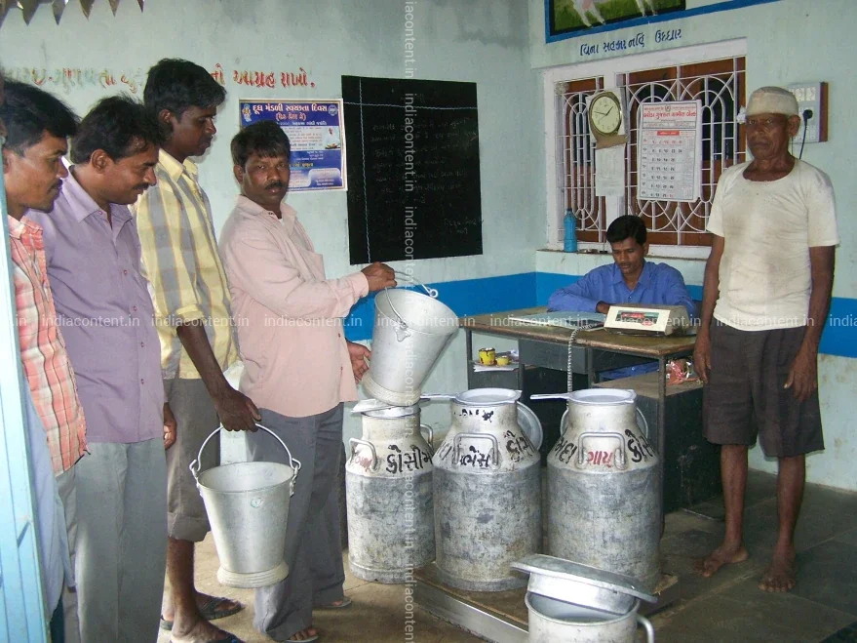
Kavin Manoharan
MILK SUPPLY CHAIN IN INDIA
In India, the milk supply chain involves multiple stakeholders like farmers, collection centers, processing units, distributors, and retailers.

Slide 8
STEP 2
COLLECTION CENTER VERIFIES AND RECORDS MILK QUALITY.
{
"Collection": {
"CenterID": "CC456",
"Temperature": "4°C",
"Timestamp": "2025-02-08T09:15:00Z"
}
}
Kavin Manoharan

Slide 9
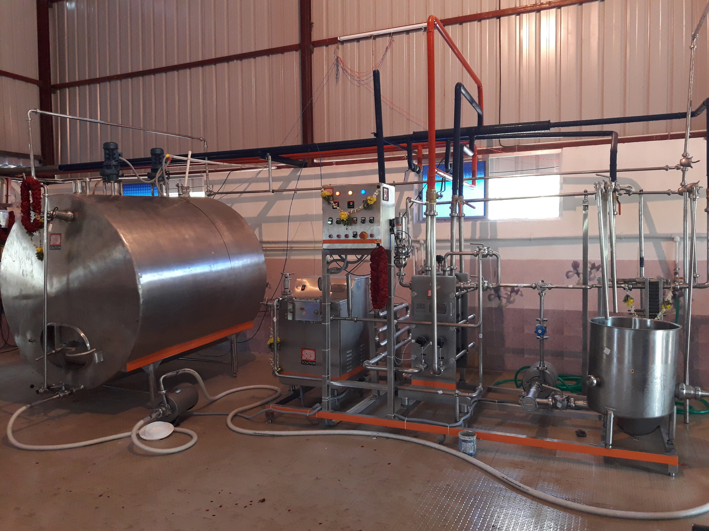
Kavin Manoharan
MILK SUPPLY CHAIN IN INDIA
In India, the milk supply chain involves multiple stakeholders like farmers, collection centers, processing units, distributors, and retailers.

Slide 10
STEP 3
PROCESSING UNIT PASTEURIZES AND PACKAGES THE MILK.
{
"Processing": {
"DairyID": "DAIRY101",
"BatchNumber": "BATCH789",
"Pasteurization": "72°C for 15s"
}
}
Kavin Manoharan

Slide 11
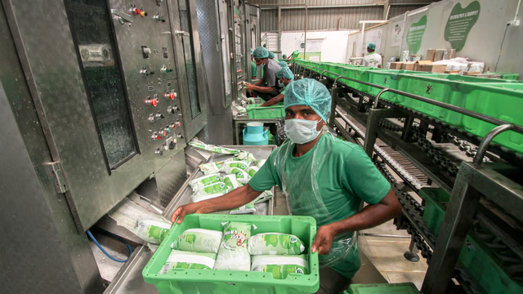
Kavin Manoharan
MILK SUPPLY CHAIN IN INDIA
In India, the milk supply chain involves multiple stakeholders like farmers, collection centers, processing units, distributors, and retailers.

Slide 12
STEP 4
MILK IS SHIPPED TO RETAILERS.
{
"Distribution": {
"ShippedTo": "Aavin Outlet, Trichy",
"DeliveryDate": "2025-02-10T09:00:00Z"
}
}
Kavin Manoharan

Slide 13
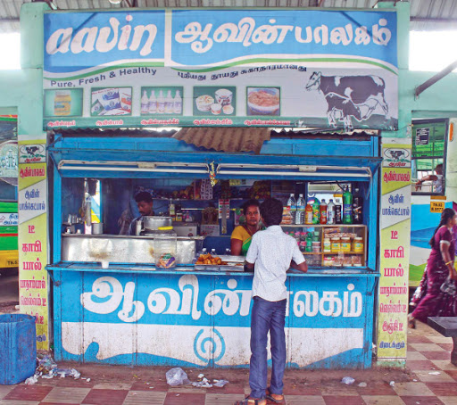
Kavin Manoharan
MILK SUPPLY CHAIN IN INDIA
In India, the milk supply chain involves multiple stakeholders like farmers, collection centers, processing units, distributors, and retailers.

Slide 14
STEP 5
MILK IS MADE AVAILABLE TO CONSUMERS.
{
"Retail": {
"ShelfLife": "5 days",
"Timestamp": "2025-02-11T09:30:00Z"
}
}
Kavin Manoharan

Slide 15
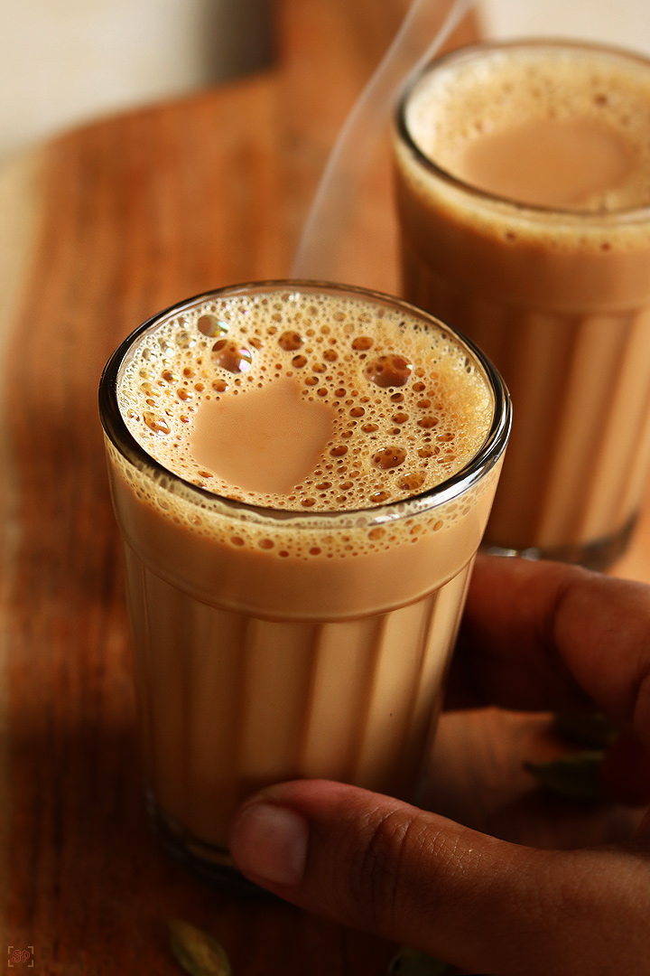
Kavin Manoharan
MILK SUPPLY CHAIN IN INDIA
Finally, to us! 😋

Slide 16
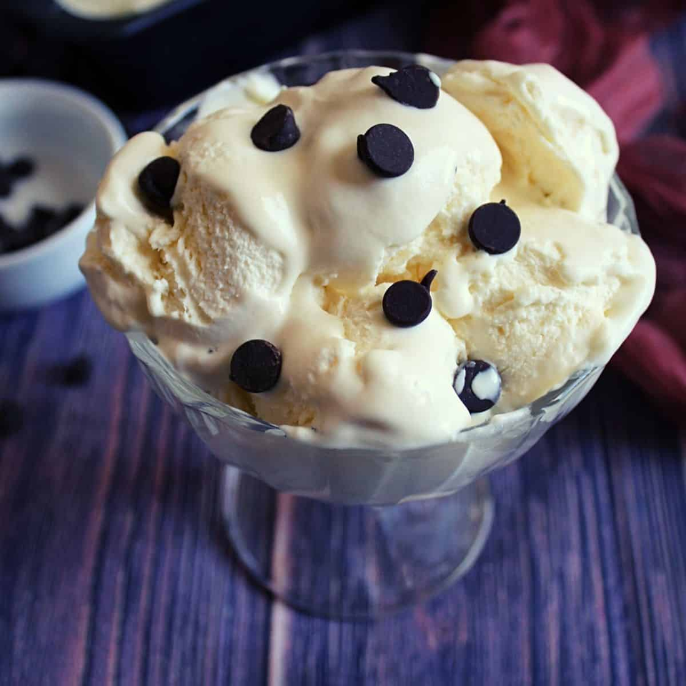
Kavin Manoharan
MILK SUPPLY CHAIN IN INDIA
Finally, to us! 😋

Slide 17
Kavin Manoharan
😋
BENEFITS
Transparency
Fair Payments
Quality Assurance
Efficiency

Slide 18
Kavin Manoharan
GOALS
No one is trust each other
TRUSTLESS

Slide 19
Kavin Manoharan
PROCESS
Everyone holds exactly the same copy of the data at the same instance of the time
DECENTRALIZATION

Slide 20
Kavin Manoharan
TRUSTLESS DECENTRALIZATION
≡
BLOCKCHAIN

Slide 21
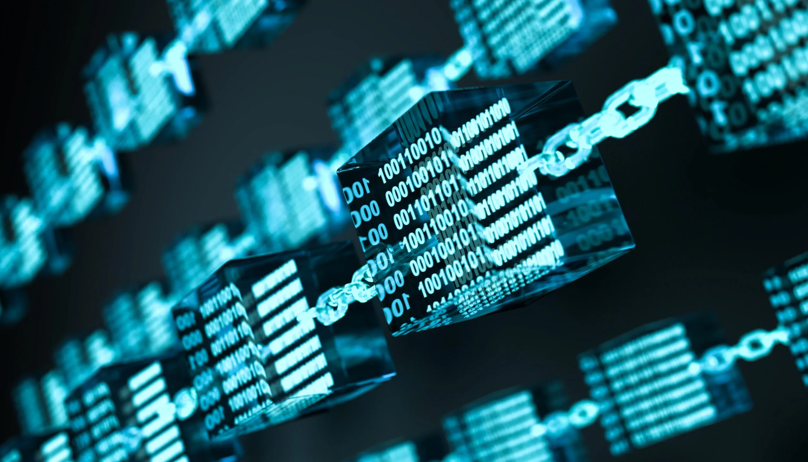
Kavin Manoharan
A DECENTRALIZED IMMUTABLE APPEND-ONLY PUBLIC LEDGER​
codiscuss.in/blockchain

Slide 22
Kavin Manoharan
😋
DIVE IN!
Hash Function
Cryptocurrency
Smart Contract

Slide 23



Kavin Manoharan
THAT’S IT
kavinsde@yahoo.com
@kavinsde

Slide 24
Kavin Manoharan
THANK YOU!
FOR YOUR ATTENTION
www.codiscuss.in/kavin

